Slide 1

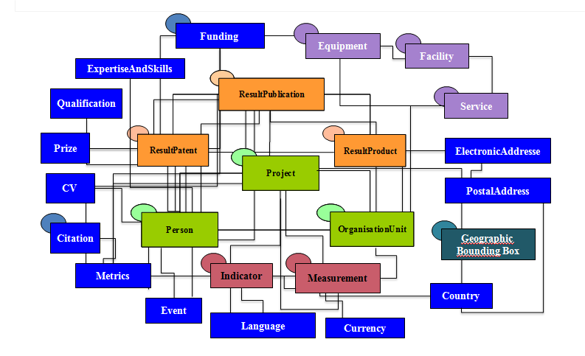
CERIF: Common European Research Information Format
An international standard relational data model for storage and interoperability of research information.
Official EU Recommendation to Member States.
Reference model for the development of Research Information Systems (CRIS)
Standard exchange format (CERIF-XML) for interoperability between systems.
Strong points of CERIF:
  Broad coverage: includes all aspects of RI (projects, persons, organisations, funding, publications, datasets, patents, products, bibliometrics, impact indicators, equipment, etc…).
  Fine-grained structure and flexible architecture, allowing:
    In- and output of virtually any (meta)dataformat used in the RI Domain
    The expression (“translation”) of virtually any formalized use case.
    The ingestion of an unlimited number of controlled vocabularies
    (taxonomies, thesauri,...) – “semantic layer”.
  CERIF = comprehensive “legobox” of research information metadata.

Slide 2
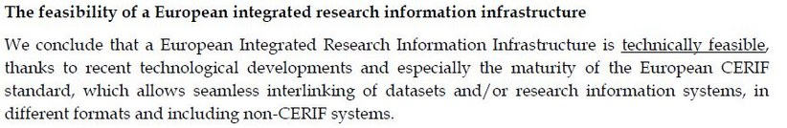

From a report by a working group of the
European Parliament
STOA-Report: Measuring Scientific Performance for Improved Policy Making, p. 14.

Slide 3
Key feature of CERIF: Linking Entities
Basic principle of CERIF: most of the characteristics (attributes) of an object (entity) are not stored with the entity (in the entity table) but expressed through “linking entities” (in database terms: linking tables), allowing multiple roles/characteristics to be expressed for the same aspect. Only the absolute unique characteristics of an entity are stored in the entity table.
E.g. for the entity “Person” only a unique identifier, the gender and the birth date are stored with the entity itself.
PERSON
Identifier
Gender
Birth date

Slide 4
Key feature of CERIF: Linking Entities
Linking entities are used to:
  Express the type and meaning of a relation between two objects in the field of
  research information, e.g.: the role of a researcher in a project, or in a publication.
  Classify objects according to a given classification scheme (controlled vocabulary,
  thesaurus), e.g.: classify a project or a publication according to a keyword list used in a
  discipline.
  Map various classification schemes to each other, e.g. map the Biochemistry keyword
  list used by the Medical discipline to the one used by Biologists; or another example:
  mapping researcher classifications used in one country to the one used in another
  country, etc….
Linking entities have a start- and enddate, so that the exact time frame of each relation or
classification is always known.
An in principle endless number of linking entities (roles, typologies...) can exist between
objects, e.g: a person can be a researcher but at the same time manager of a project.

Slide 5
Example 1: a researcher with various roles in a project
PERSON_PROJECT
PERSON
PUBLICATION
DATASET
PROJECT
Person Id
Project Id
Role: researcher
Start: 01-01-2010
End: 31-12-2013
PROJECT
PERSON_PROJECT
Person Id
Projec Id
Role: manager
Start: 01-03-2011
End: 31-12-2013
.
The person is researcher in the project from 2010 on and from March 2011 on he is also the manager of the project. To express this in CERIF there are two records in the “Person-Project” linking entities table, one for each role, with start- and enddate.

Slide 6
Example 2: Classifying a given publication according to the subject field or area it belongs to.
PERSON
PUBLICATION
PERSON
DATASET
PUBLICATION
PROJECT
PUBLICATION
PERSON_PUBL.
CLASSIF-SCHEME
PUBL_DATASE
PUBL_CLASS
PERSON_PROJECT
Publ_Id
Class_term Id
Class_Scheme Id
Start:
End:
E.g. Subject Areas
Person Id
Publ. Id
Meaning (e.g.:
1st author, editor...)
Publ. Id
Dataset Id
Meaning (e.g.:
based on)
Person Id
Projec Id
Meaning (e.g.:
researcher, manager)
Linking entity connecting the publication to the correct subject area. Notice: also here more linking entities (records) are possible since a publication may be relevant for various disciplines or subject areas.

Slide 7
Example 3: Map various classification schemes (e.g. keyword lists)
CLASSIF-SCHEME
CLASSIF-SCHEME
PERSON
PUBLICATION
PERSON
DATASET
PUBLICATION
PROJECT
E.g. Biochemstry keywords as used by Medical disciplines
CLASS_CLASS
E.g. Biochemstry keywords as used by Biologists
PERSON_PUBL.
PUBL_DATASE
PERSON_PROJECT
Class_term Id A
Class_term Id B
Relation
(e.g. Is equal to, is subtype of, etc...)
Person Id
Publ. Id
Meaning (e.g.:
1st author, editor...)
Publ. Id
Dataset Id
Meaning (e.g.:
based on)
Person Id
Projec Id
Meaning (e.g.:
researcher, manager)
Classification Scheme A
Classification Scheme B
Linking table mapping a term from Scheme A to a term from Scheme B, including expression of the nature or meaning of the relation between the two terms.

Slide 8
All the classifications and typologies are stored in a separate part of the CERIF model, the Semantic layer.
PERSON
PUBLICATION
PERSON
DATASET
PUBLICATION
PROJECT
OBJECT A
OBJECT B
PERSON_PUBL.
PUBL_DATASE
PERSON_PROJECT
OBJECTA_OBJECTB
ObjectA Id
ObjectB Id
Meaning:
Start:
End:
Person Id
Publ. Id
Meaning (e.g.:
1st author, editor...)
Publ. Id
Dataset Id
Meaning (e.g.:
based on)
Person Id
Projec Id
Meaning (e.g.:
researcher, manager)
Class. Scheme 1
Class. Scheme 2
Class. Scheme 3
Class. Scheme N
E.g. Roles of a Person in a Project.
E.g. Roles of a Person in a Publication.
E.g. Types of Research
Results
E.g. Keywords used to classify research in a given discipline.
..........
Semantic layer holding the Controlled Vocabularies to express the Meaning of the relation.

Slide 9
Implemented in a CRIS these are all Database Tables.
T
A
B
L
E
S
PERSON
PUBLICATION
PERSON
DATASET
PUBLICATION
PROJECT
OBJECT A
OBJECT B
PERSON_PUBL.
PUBL_DATASE
PERSON_PROJECT
OBJECTA_OBJECTB
ObjectA Id
ObjectB Id
Meaning:
Start:
End:
Person Id
Publ. Id
Meaning (e.g.:
1st author, editor...)
Publ. Id
Dataset Id
Meaning (e.g.:
based on)
Person Id
Projec Id
Meaning (e.g.:
researcher, manager)
T
A
B
L
E
S
Class. Scheme 1
Class. Scheme 2
Class. Scheme 3
Class. Scheme N
E.g. Roles of a Person in a Project.
E.g. Roles of a Person in a Publication.
E.g. Types of Research
Results
E.g. Keywords used to classify research in a given discipline.
..........
Semantic layer holding the Controlled Vocabularies to express the Meaning of the relation.

Slide 10
Real life example of (part of) CERIF with linking entities (pink) filled in.

Slide 11
Real life example: applying multiple keyword classifications to a publication

Slide 12
Real life example: Mapping Classification Schemes in CERIF

Slide 13
Example of a real life use case

Slide 14
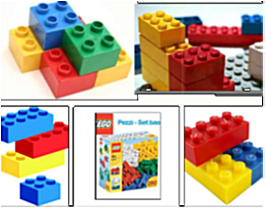
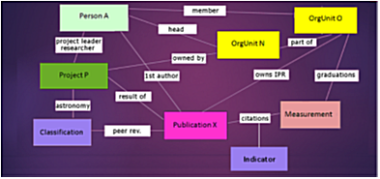

CERIF: summarising
CERIF: Comprehensive “legobox”covering all aspects of research.
Can express virtually any combination of data from/into
virtually any use case.
Widely recognized within Europe as a standard storage model for research information metadata and a standard for interoperability of research information (CERIF-XML).
Reference for development of CRIS, e.g.

